Slide 1
Hamster Capstone Project
Presentation 3 by: Jared Hemauer, Rylee Horney, Keenan Keams, Joseph Lopez

Slide 2

Current Review of Hamster
Hamster is an affordable device for stroke rehabilitation
Help gain basic movements in the arm and hand of the patient
Sponsor: Dr. Reza Sharif Razavian
  NAU Professor
Joe, 1

Slide 3
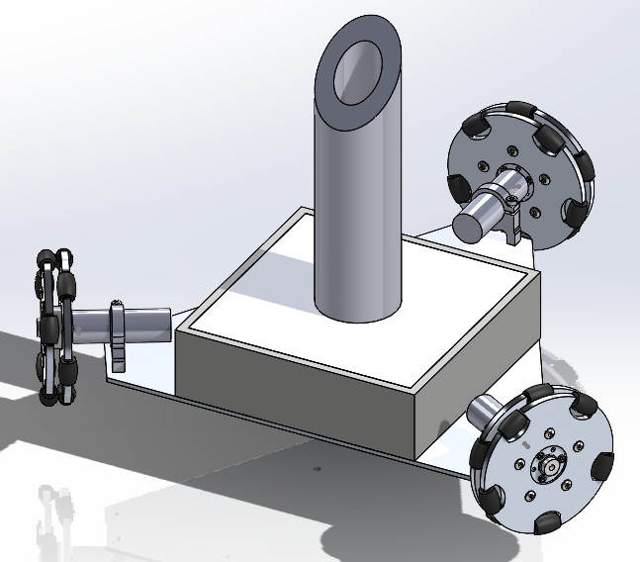
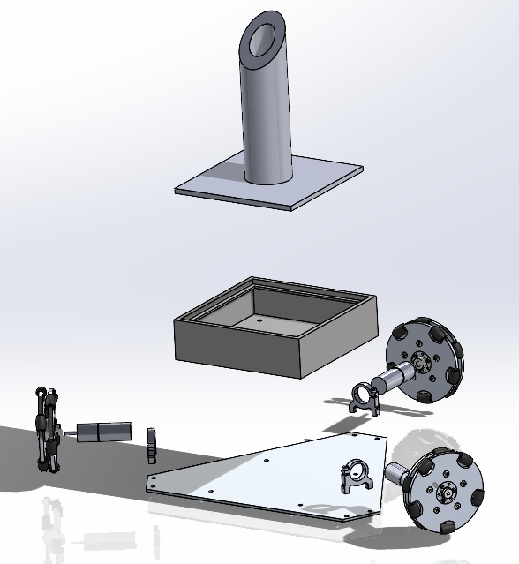
SOLIDWORKS View
Figure 1. CAD Model of Full Design​
Figure 2: CAD assembly exploded view
Jared, 2

Slide 4
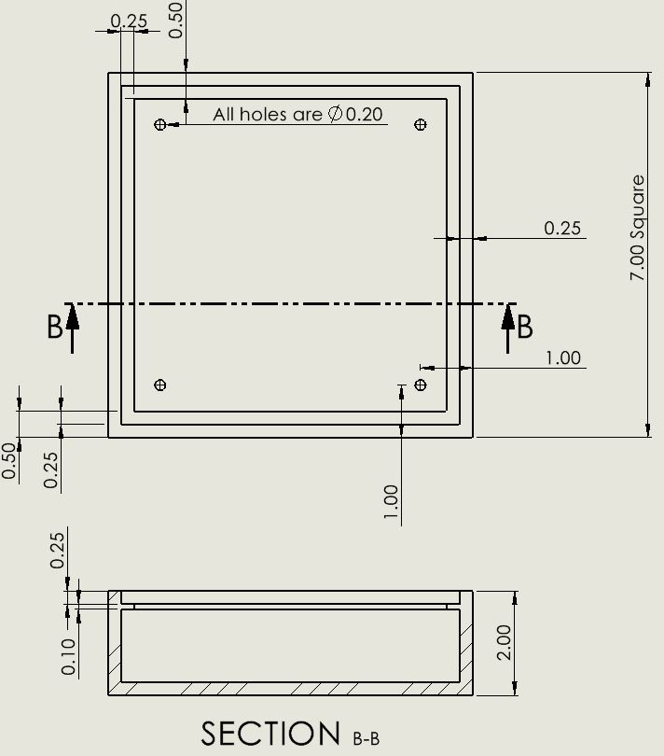
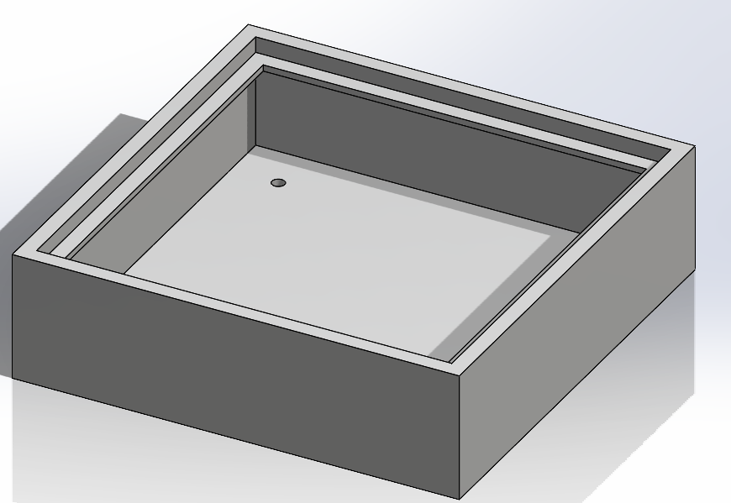
Component Enclosure Sub-design
Figure 4: Component Enclosure CAD
Figure 3: Component Enclosure drawing
Jared, 3

Slide 5
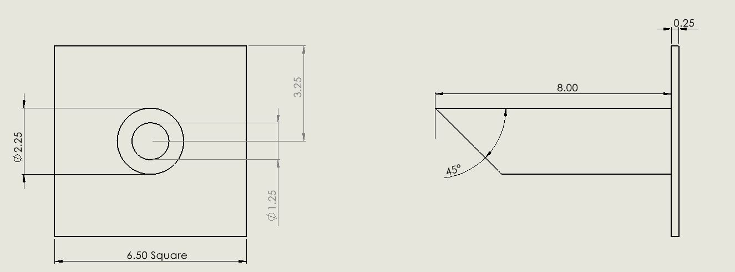
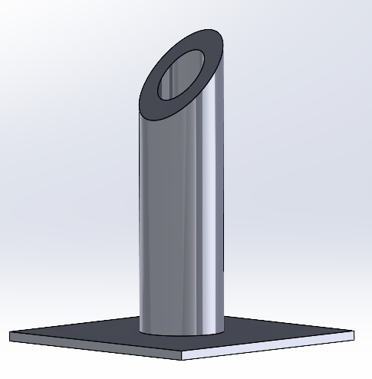
Top Plate & Handle
Figure 5: Top Plate Drawing
Figure 6: Top Plate CAD
Jared,4

Slide 6
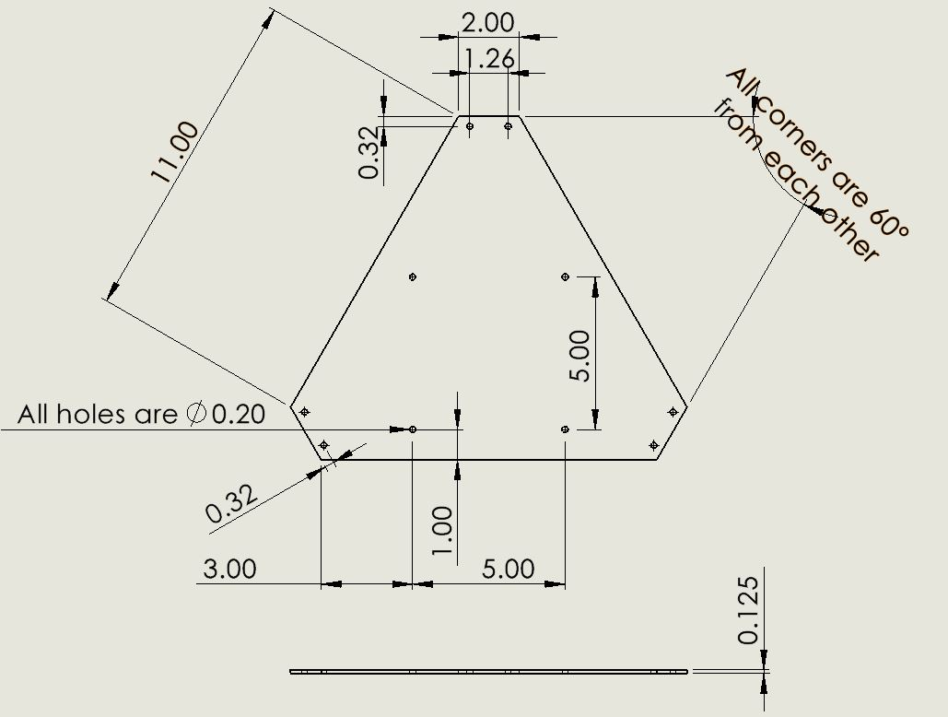
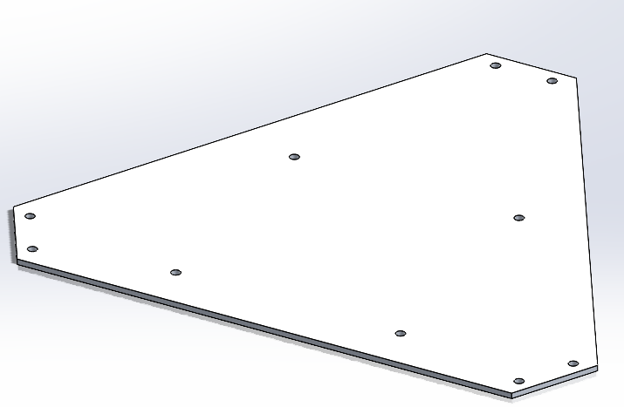
Aluminum Chassis Sub-design
Figure 8: Chassis CAD
Figure 7: Chassis Drawing
Jared, 5

Slide 7
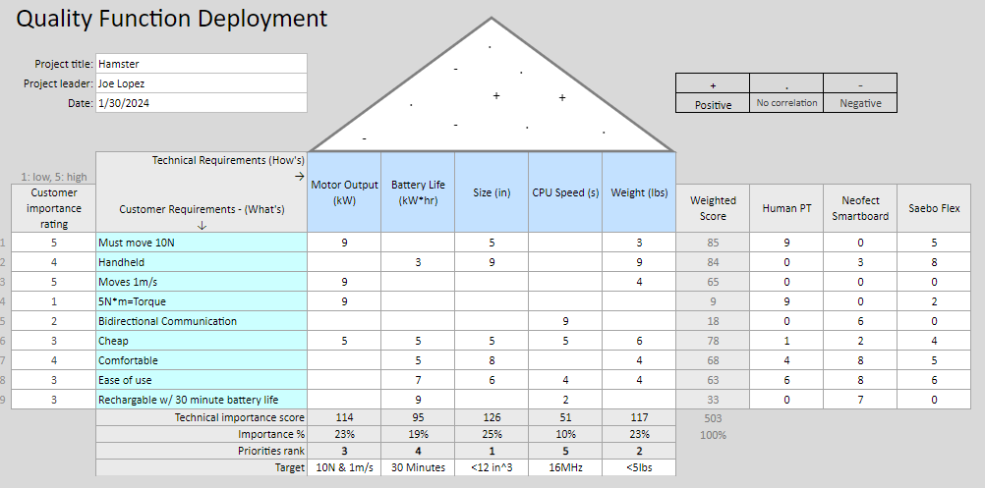
Updated QFD
Rylee, 6

Slide 8



Engineering Calculations
Motor Torque Requirements:
Work is based on given requirements from the client and the length of the current design of Hamster. Overall, a motor with at least 3.7 kgf-cm should work
Joe, 7

Slide 9
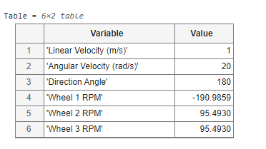
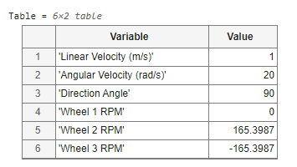
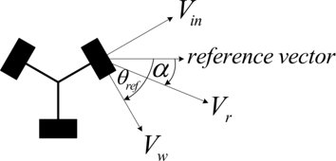
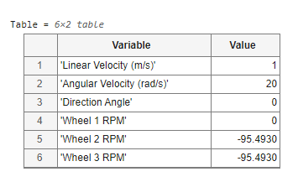
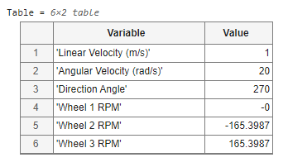
Engineering Calculations Cont.
Wheel Speeds to go Left
Wheel Speeds to go Forward
Wheel Speeds to go Right
Wheel Speeds to go Back
Figure 9: Omni-wheel vector diagram [1]
Rylee, 8

Slide 10
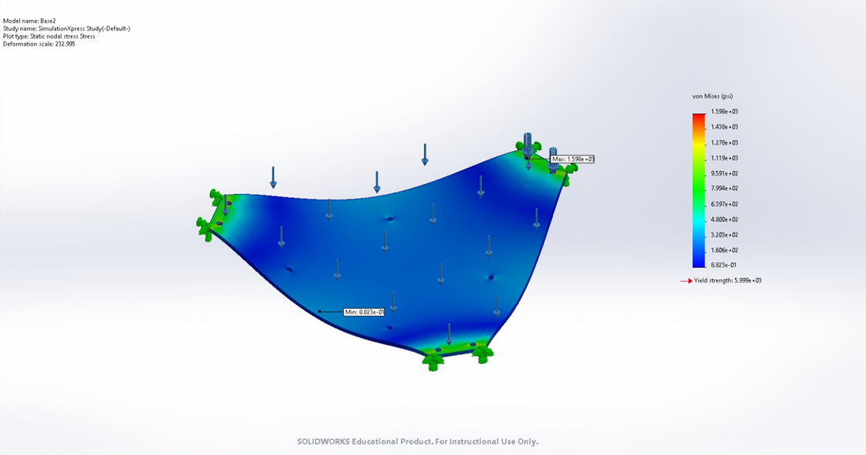
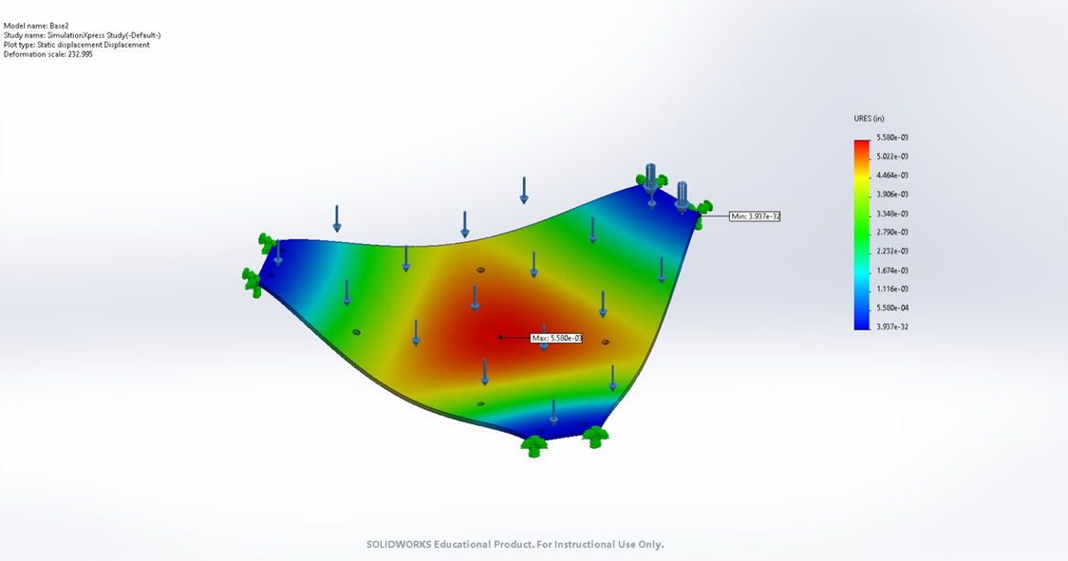
Engineering Calculations Cont.
Figure 10: Stress Diagram
Figure 11: Displacement Diagram
Evaluation done in Simulation XPRESS in SOLIDWORKS using 1/8in. 3003 Aluminum Plate
With a 10lbf load applied the plate will have:
FOS: 3.75
Max Displacement: 5.58e-3 in. (.142 mm)
Stress: 1.6e3 psi (1.1e7 Pa)
Jared, 9

Slide 11

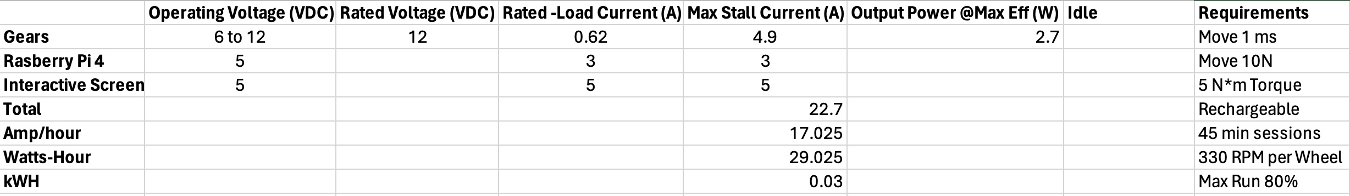
Engineering Calculations Cont.
To find the size of battery needed we had to calculate all the amps needed to supply our parts within the system. We then add them up and multiply by the time needed which will give us the Apm-Hour. After multiplying by the Voltage and well get the Watt-Hour. That will help us have a big enough battery to last 45-minute sessions with our current Apm ratings.
Keenan, 10

Slide 12
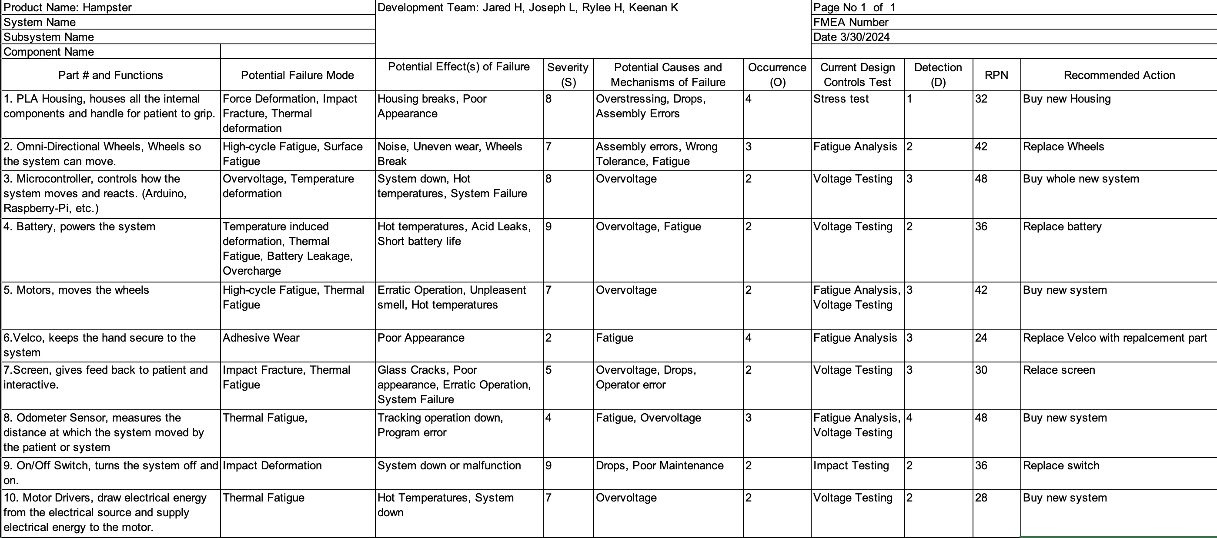
Design Validation (FMEA)
Keenan, 11

Slide 13
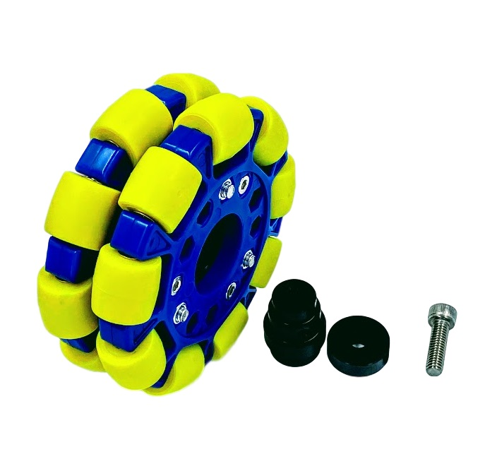
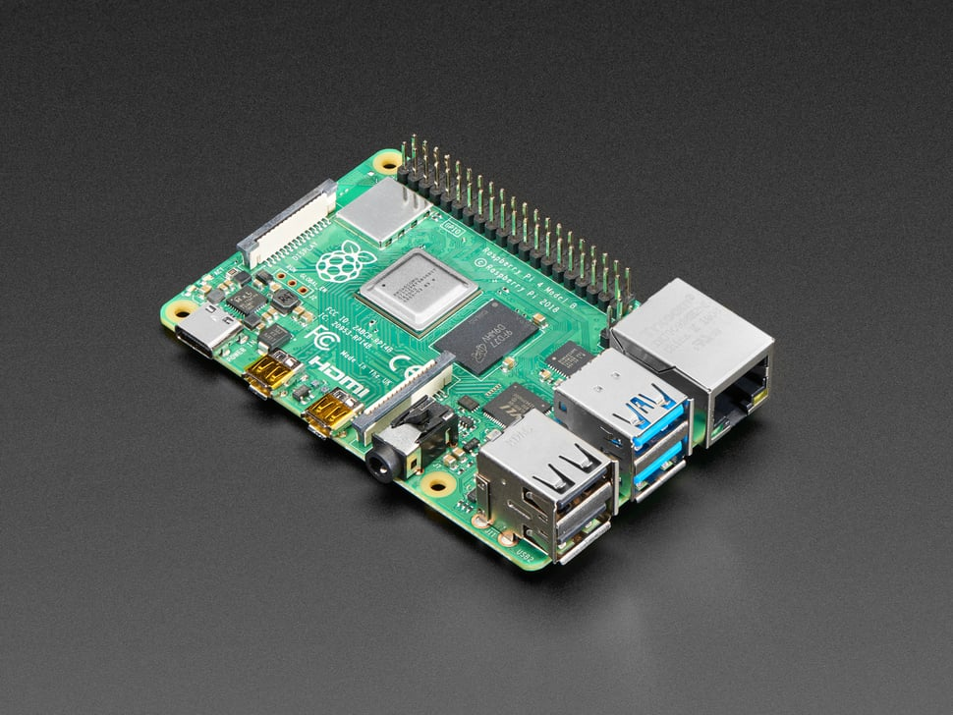
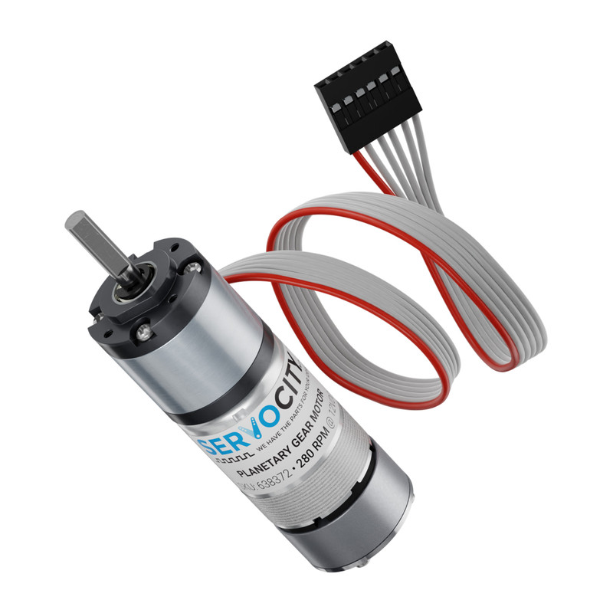
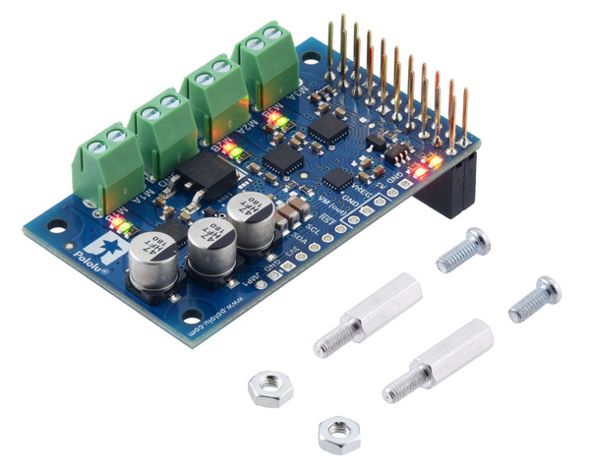
Testing Procedures
Testing ordered parts.
Using given measurements from website to check if components fit in casing.
Messing around with Raspberry Pi and motor controller.
Joe, 12

Slide 14
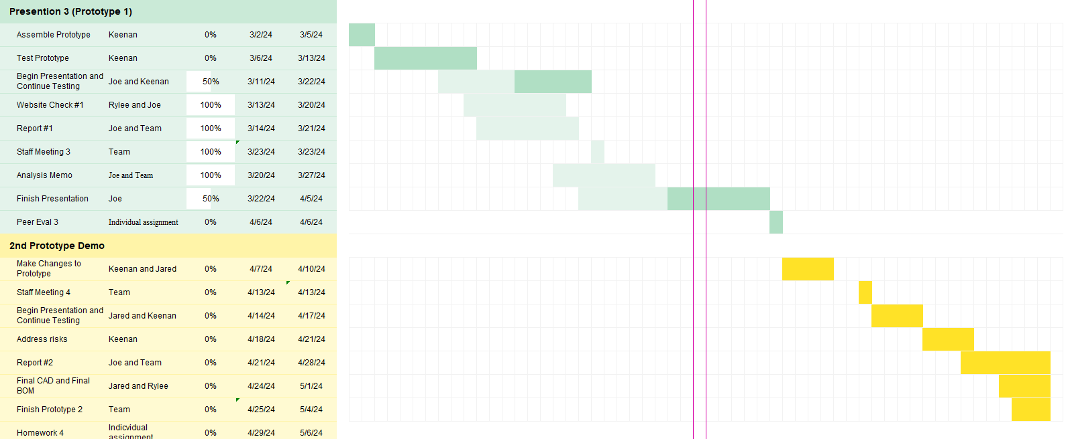
Scheduling
Joe, 13

Slide 15
Budgeting
Total Dollars Available: $1200
Fundraising: Completed total of $200
Expenses to Date: $ 262.00
Anticipated Expenses: about $350 - $400
  This would be for 2 more motors, 2 more wheels, battery, sensors, and other components
Resulting Balance: $938.00
Part​ | Cost of Part​ | Quantity​ | Estimated Total Cost​
PLA​ | $20​ | 1-2 spools​ | $40​
Omni-Directional Wheels​ | $30-$40​ | 3 wheels​ | $90-$120​
Microcontroller (Arduino, Raspberri-Pi, etc)​ | $20-$30​ | 1​ | $20-$30​
Battery​ | $30-$50​ | 1​ | $30-$50​
Motor(s)​ | $70-$100​ | 3​ | $210-$300​
Velcro​ | $8 (roll)​ | 1​ | $8​
Screen ​ | $30​ | 1​ | $30​
Sensor​ | $20​ | 1​ | $20​
ON/OFF Switch​ | $5​ | 1​ | $5​
Motor drivers​ | $20​ | 3​ | $60​
Table 1. Tentative Bill of Materials
Rylee, 14

Slide 16
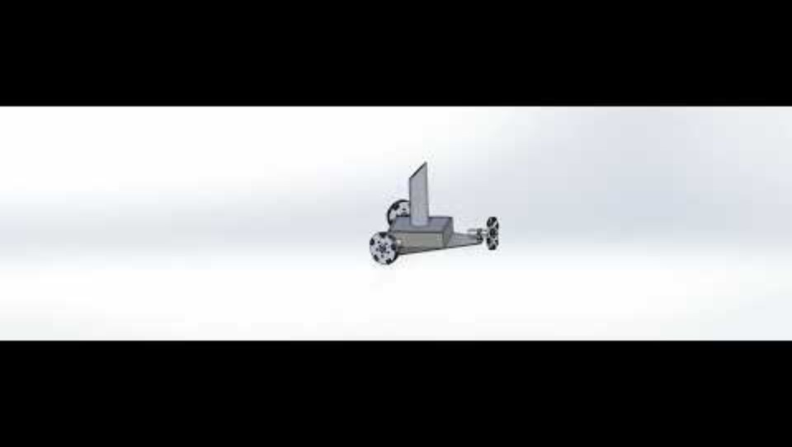
Virtual Prototype Demo
Joe, 15

Slide 17
Thank you

Slide 18
References
[1]J. Inthiam and C. Deelertpaiboon, "Self-localization and navigation of holonomic mobile robot using omni-directional wheel odometry," 2014

